Slide 1
Unit 7 Summer

Slide 2
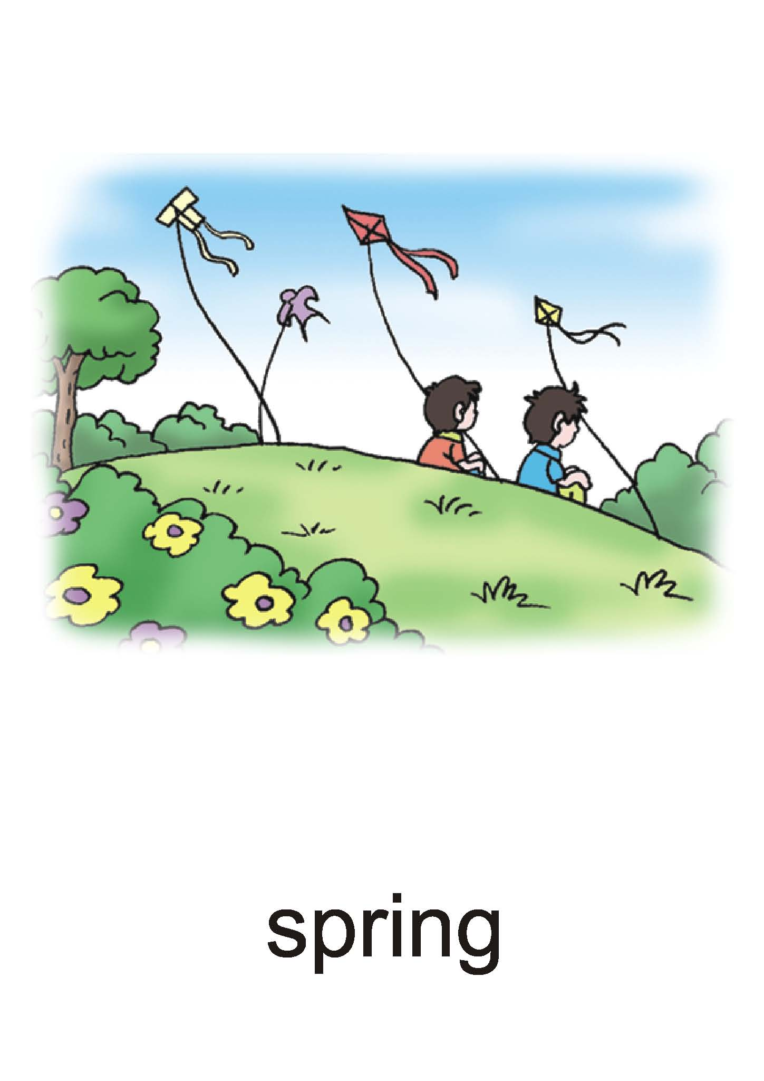
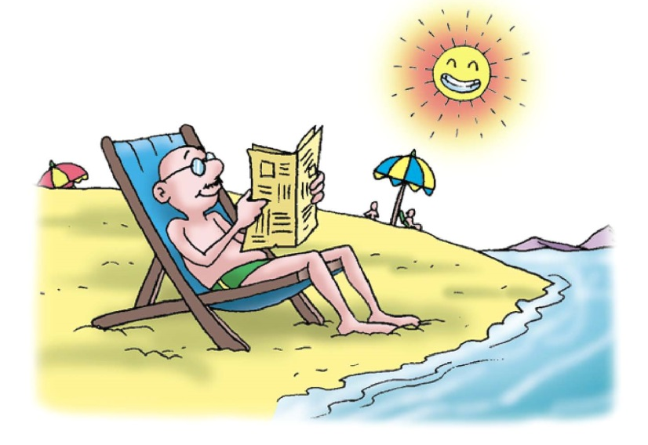
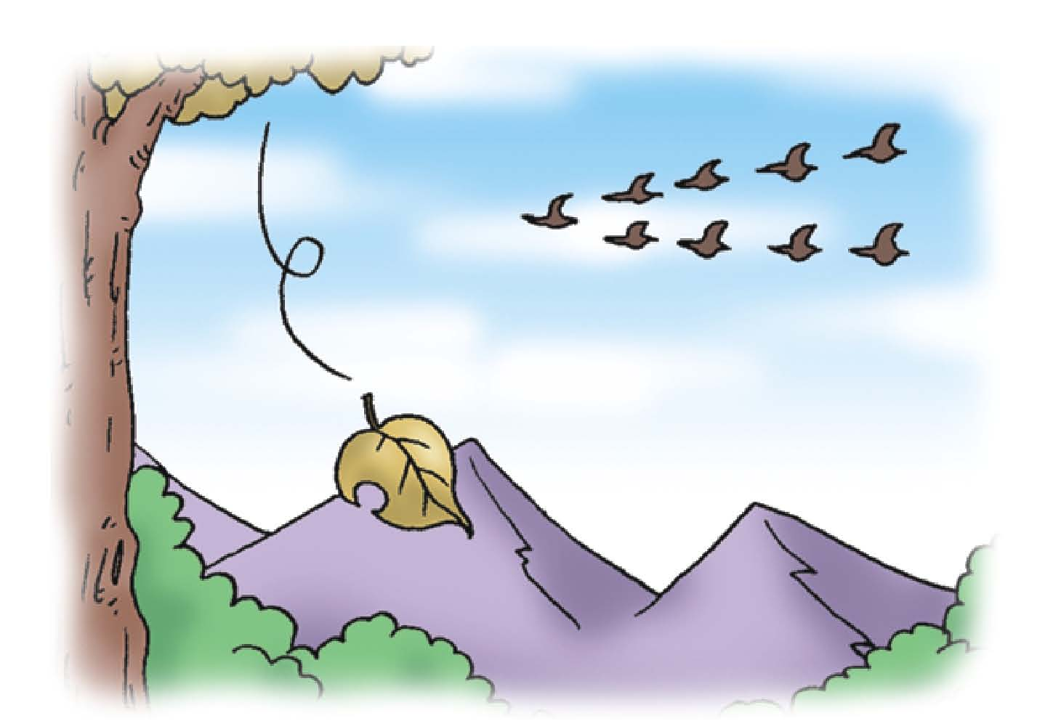
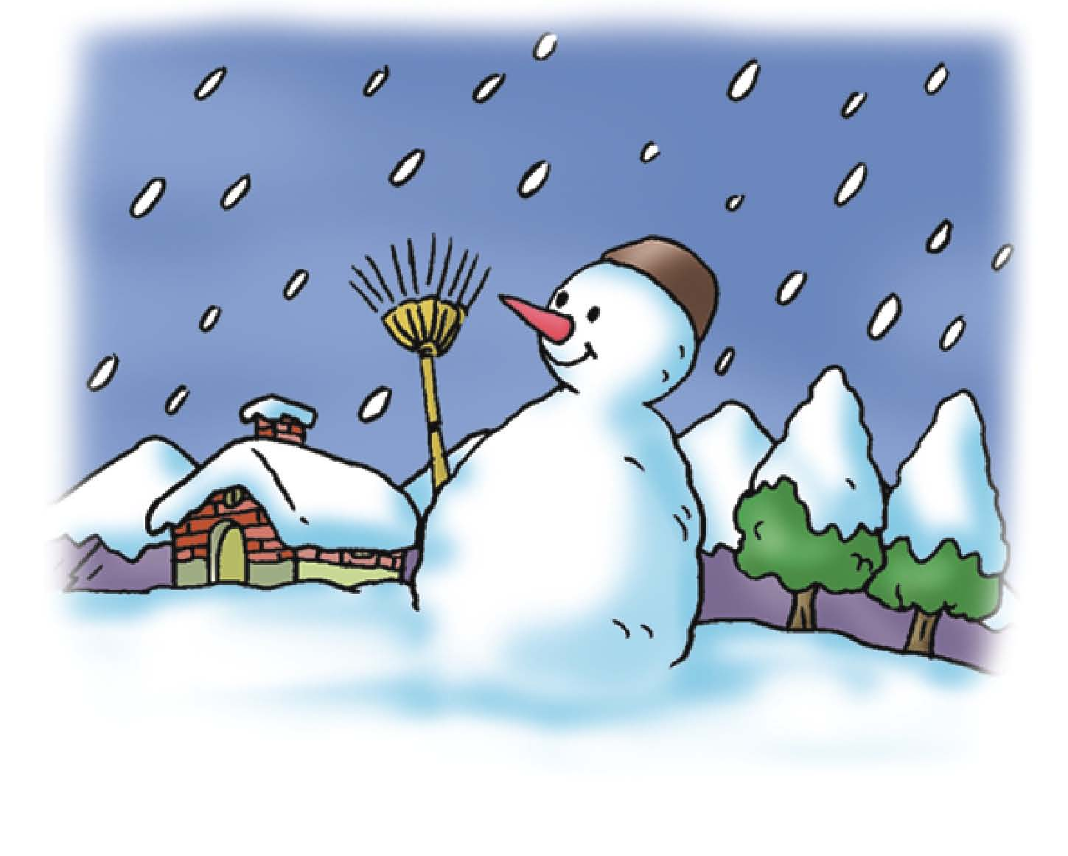
What season?

Slide 3
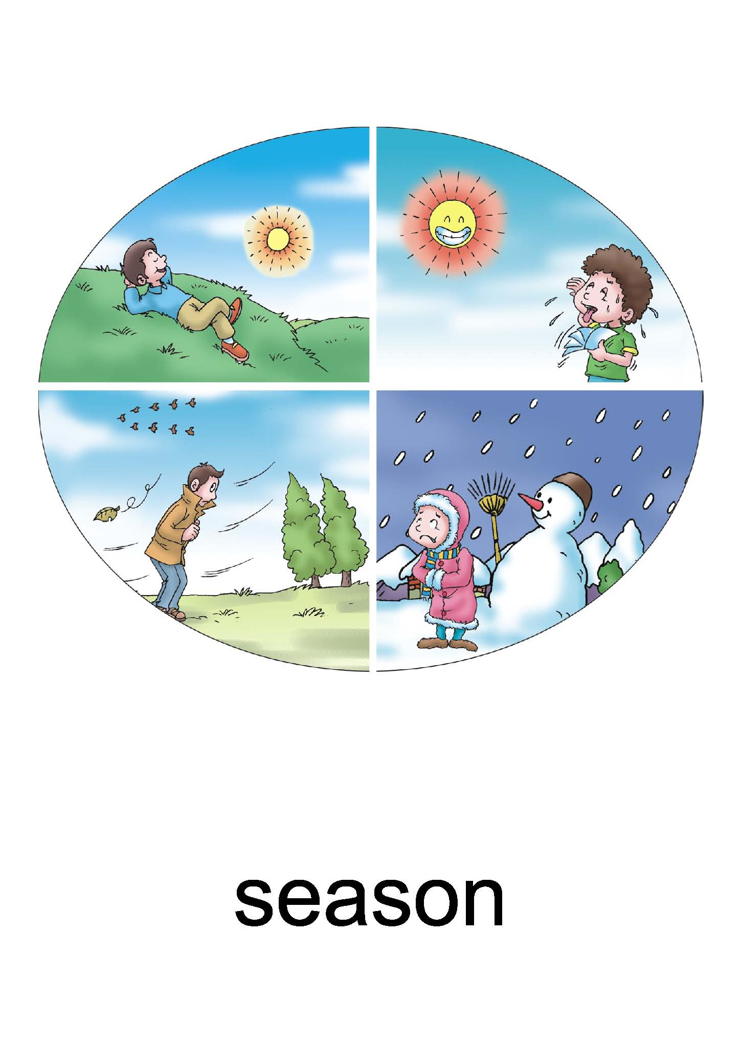
There are four seasons in a year.
summer
spring
autumn
winter

Slide 4
In Spring/Summer/Autumn/Winter
在春天/夏天/秋天/冬天

Slide 5

Pair
Work

Slide 6
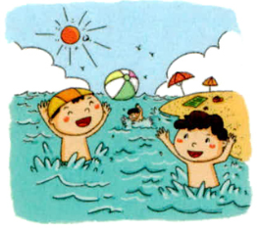
In Summer, I swim in the pool.

Slide 7
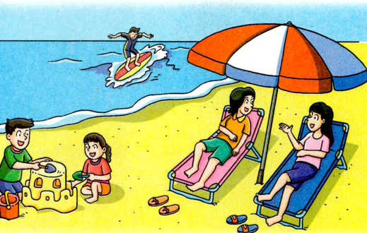
In Summer, I play on the beach.

Slide 8
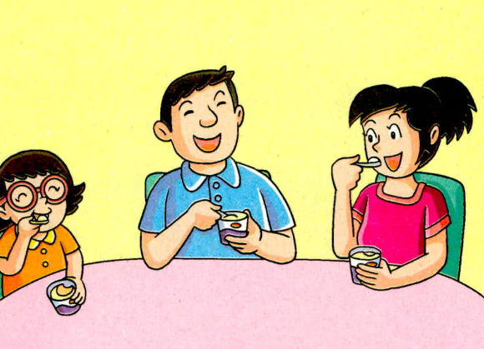
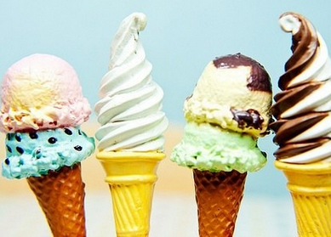
In Summer, I eat ice cream.

Slide 9
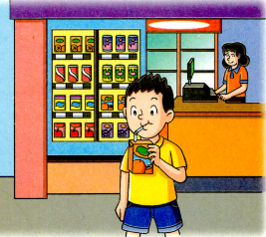
In Summer, I drink orange juice.

Slide 10
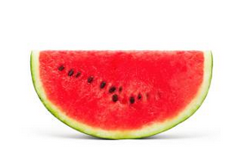
In Summer, I eat watermelons.

Slide 11
Let's
practice!

Slide 12
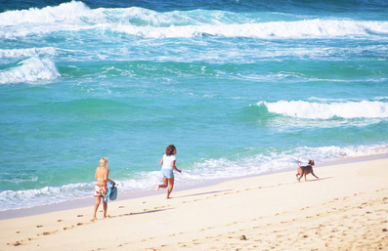
In Summer, I play on the beach.

Slide 13
In Summer, I eat ice cream.

Slide 14
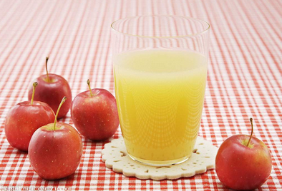
In Summer, I drink orange juice.

Slide 15


